Slide 1
Key Challenges for Intent-Driven Mobile Network Management
Seminar
Software Engineering for Distributed Systems
Sommersemester 2022
Vladyslav Kolesnykov
Advisor: Tobias Foth
Software Methodologies for Distributed Systems (Prof. Bauer)
University of Augsburg

Slide 2
Agenda
Motivation
Definition of Intent-Driven Networking
IDN Management process
Generic IDN Architecture
Advantages of IDN
Challenges of IDN
Conclusion

Slide 3
Motivation
6G challenges:
A peak data rate of at least 1 Tb/s and a user-experienced data rate of more than 1 Gb/s.
An over-the-air latency of <10 ms.
Ten times the connectivity density of 5G.
Massive machine-type communication (IoT, autonomous vehicles, smart cities)
increasing maintenance costs, error probability, and low management efficiency.
Future mobile networks should adopt automation capabilities by applying a deeper level of intelligence.
Notes:
A mobile network is a communications network that provides a wireless connection to individual devices.
transmitting data via radio waves from end-user devices to a transceiver.
Current netwotks apply softwarizaztion and Virtualization.
However, future mobile networks should be self-configuring, self-managing, and self- optimizing.

Slide 4
Intent-Driven Networking
Intent-driven networking (IDN) is a concept aimed at automating network administration tasks with reliance on artificial intelligence.
The intent is a declarative way to define the desired state of the network that can be translated into specific configurations.
Example: "a cell should have a range of 1 km with a data rate of 100 Mbit/s.”
The intent-driven network can automatically deploy, configure, verify and optimize itself to achieve a target state defined by intent.
Notes:
- promising network concept that has received great attention from industry and open source communities in recent years.
- High-level intents offer an efficient and powerful way of expressing network requirements to manage its infrastructure, resources, and services without providing exact configurations.
- tends to automate conventional networking by applying a deeper level of intelligence.
- Instead of performing manual network management, the network is provided with desired business intent that is used to express all requirements to be automatically fulfilled by a system.
- The network is able to automatically deploy, configure, verify and optimize itself to achieve a target state defined by intent

Slide 5
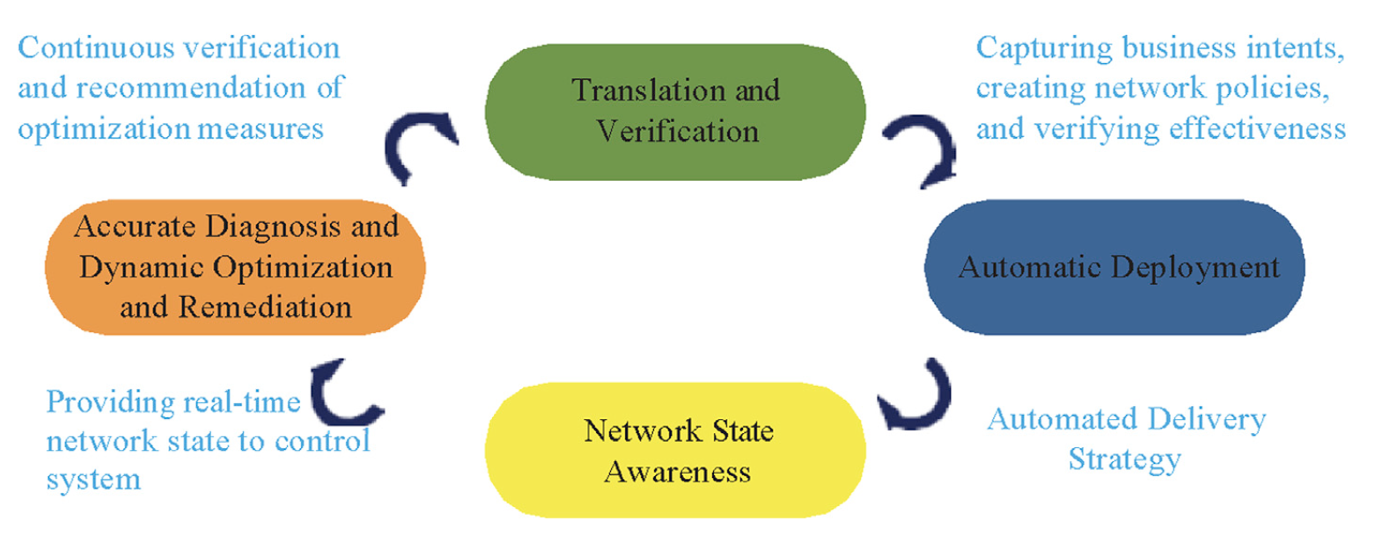
IDN Management process
Wei, Y.; Peng, M. & Liu, Y. “Intent-based networks for 6G: Insights and challenges“ In: Digital Communications and Networks
Notes:
Network management is a set of tools with is designed to Deploy, maintain, optimize and update the network. These tools manage underlying devices, such as routers, switches, access point, etc. IDN management provides four main functional blocks.
Translation and verification. The IDN captures and translates business intent into the necessary system configuration. The system then validates the correctness of the resulting policy.
Automatic deployment. The IDN installs translated and verified policies across physical and virtual network infrastructure through network automation and network orchestration.
Network state awareness. The state of the network may constantly change, which can lead to some inconsistencies between implementation and the desired outcome. The system needs to continuously monitor and manage the network to guarantee fulfillment of the business intent.
Accurate diagnosis and dynamic optimization. The ultimate goal is for the network to continuously monitor and adjust network performance to ensure the desired business outcome. If expected intent is not achieved, the system takes corrective actions.

Slide 6
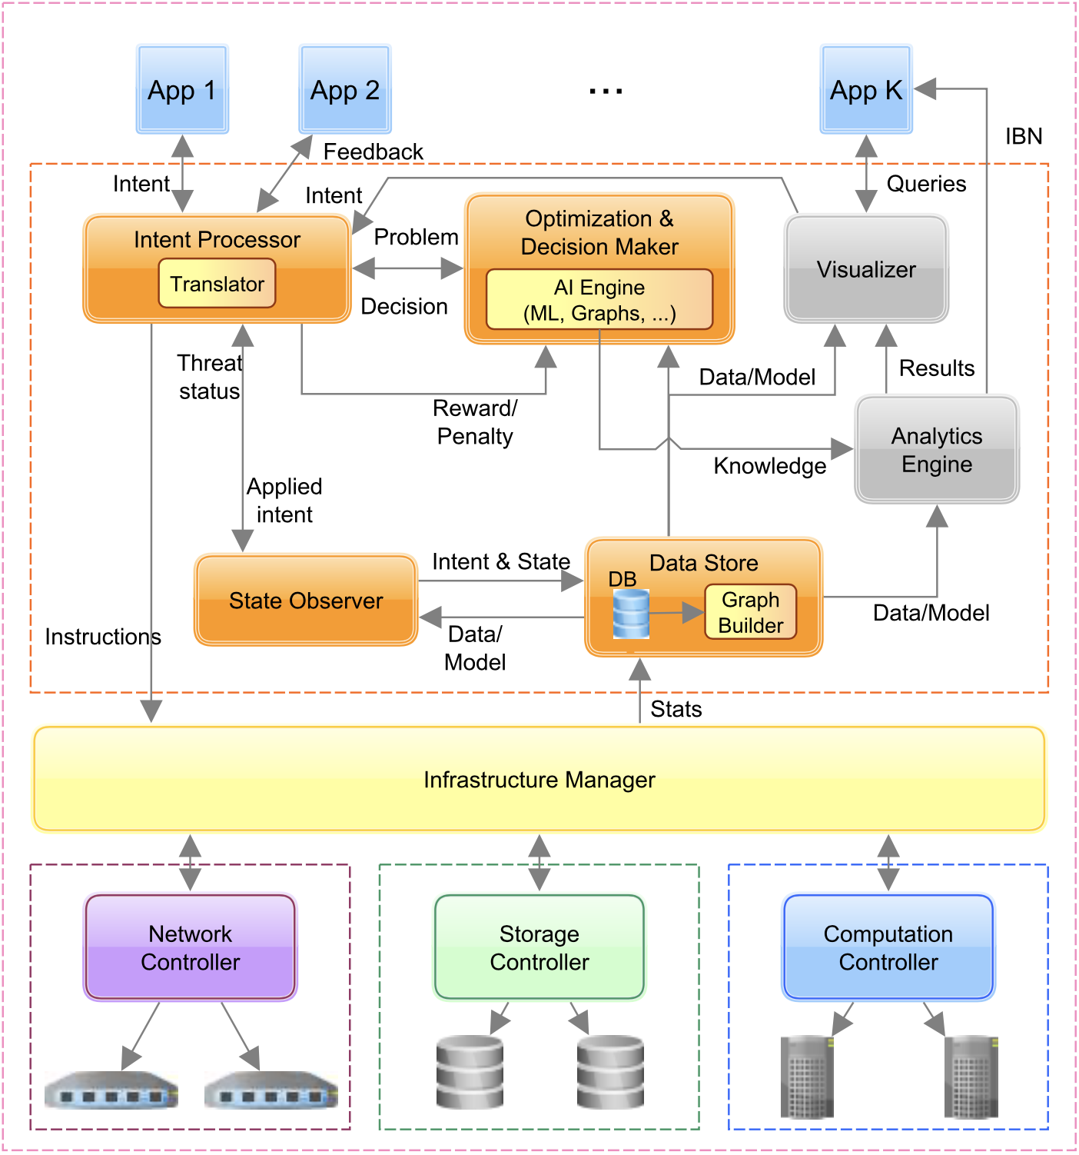
Generic IDN Architecture
Barun Saha et al. “Intent-based Networks: An Industrial Perspective”.
Notes:
Intent Processor (IP) is the core component of IDN architecture that accepts high- level intent provided by users or various applications through a corresponding interface. After new intent is provided, the translater module performs mapping into a machine-readable representation for the required modules or services. The IP is also responsible for intent assurance. Based on the information from State Observer, IP takes corrective action and assists in the reconfiguration of the underlying infrastructure to preserve the required intents.
Optimization Decision Maker (ODM) is responsible for intent verification optimization and decision making. It tries to find a feasible and the most optimal solution that is then returned to IP. Lerns to make better decisions in terms of feasibility and intent installation.
State Observer (SO) is a crucial component for intent assurance because it is responsible for monitoring the network. Based on data retrieved from DS it observes the current state and informs IP if there is any threat or inconsistency against installed intent. For instance, a node can be overloaded with network traffic leading to failure in serving a critical service.
The Infrastructure Manager (IM) represents an interface between the IP and the different controllers. IM translates feasible intents into domain-specific instructions and also collects various statistics from the controllers

Slide 7
Advantages of IDN
Fast implementation of business goals into network configurations.
Simplifies and automates network operations.
Automates troubleshooting and resolution.
Enables automatic learning and optimization.
Improves network security capabilities.
Continuous alignment of the network with the business objectives.
Notes:
1. Users can quickly provide high-level business intents, which are then translated into optimal network policies.
2. IDN reduces the complexity of the management and maintenance of the entire infrastructure.
3. IDN can recognize potential problems before they occur and immediately perform correcting actions.
4. IDN may predict any violations of the expressed intent before changes will be applied, forecast trends, identify anomalies, predict and validate system-level performance.
5. Part of the monitoring is that IDN is always looking for threats in the network data. Security violations are immediately identified and prevented.
6. ensures that the network always stays in compliance with the business goals by constantly performing intent assurance and implementation

Slide 8
Challenges of IDN
Next-generation Mobile Networks
Application of Artificial Intelligence
Intent description and translation
Intent fulfillment and conflict resolution
Lack of standardization

Slide 9
Next-generation Mobile Networks
6G should support enhanced mobile broadband, and highly reliable, low-latency, long-distance, and high-mobility communication.
Manual network management is error-prone and requires expert knowledge.
It faces the increasing complexity and the cost of network operations and maintenance.
Intelligentization, powered by AI, is the key to achieving fully autonomous network management.
Notes:
next-generation mobile networks should support enhanced mobile broadband, and highly reliable, low-latency, long- distance, and high-mobility communication.
6G must provide ultra-massive machine- type communications that support connectivity for the Internet of Things (IoT), fully autonomous vehicles and Internet of Bodies with various smart wearable devices.
increase the complexity and the cost of network operation and maintenance.
Intelligentization, powered by AI, is the key to achieving fully autonomous network management.
6G networks are expected to be intelligent to automate network operations and provide flexibility for diverse user and business requirements.

Slide 10
Application of Artificial Intelligence
AI can automate network operations in mobile networks that require human intervention.
Network operations that could benefit from AI integration:
Planning
Configuration
Monitoring
Optimization
Healing
Security assurance
Intent translation
Notes:
These tasks can be accomplished by AI technologies to ensure network performance while reducing operational costs and improving network. AI can replace fields in wireless networks that require expert knowledge by automating network operations
Planing: AI techniques like Simulated Annealing, Tabu Search can be used to solve complex network design problems, by making more accurate predictions.
An AI-enabled network can dynamically configure its components and network slices. AI techniques like Transfer Learning, Reinforcement Learning may be utilized to address configuration management with a highly automated approach.
Network monitoring. With AI-powered diagnostic analytics, the network can quickly and accurately detect problems and resolve them, even before they occur. Algorithms like Logistic Regression (LR), Support Vector Machine (SVM), and Hidden Markov Model (HMM) could be utilized for network anomaly detection.
In mobile networks, AI can dynamically manage multiple connections and select optimal mobile cells to ensure connection continuity. Based on traffic forecasting, optimal user scheduling can be selected to improve network performance and efficiency. In addition, using AI, nodes can optimize parameters to achieve load balancing and reduce retransmission overheads to enhance the reliability of data transmission.

Slide 11
Intent description and translation
Translating intents into concrete network configurations is one of the biggest challenges of IDN.
The intent should be human-readable at the application level and machine-understandable at the resource layer.
A mid-level representation might be useful for efficient intent processing and implementation.
The intent translation is based on Natural Language Processing (NLP).
Notes:
a human-readable format is preferable for users since arbitrary complex goals can be expressed in a high-level and flexible way.
For instance, NLP can be used for understanding the intent structure and its translation through Sequence-to-Sequence (seq2seq) learning models such as recurrent neural networks (RNN) and advanced models including attention, Bidirectional Encoder Representations from Transformers (BERT).

Slide 12
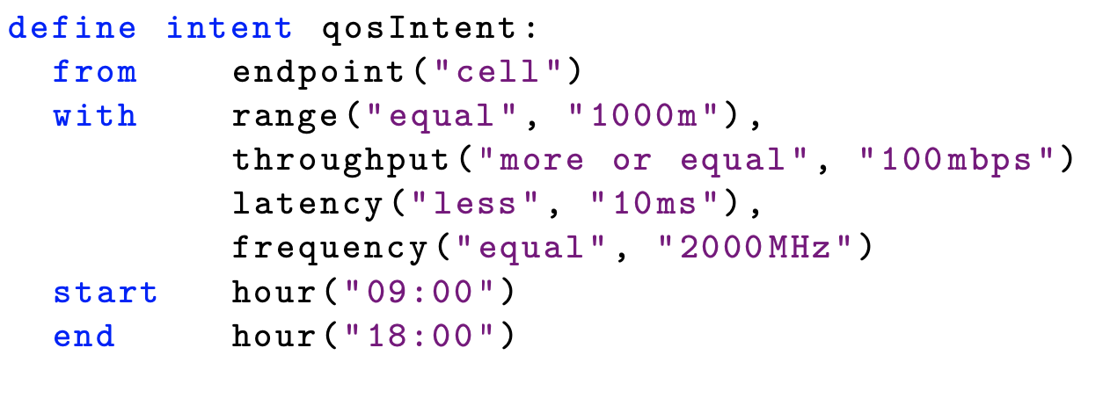
Nile intent example
Example: ”Every day from 09:00 to 18:00, the cell should have a range of 1 km with a data rate of 100 Mbit/s, latency under 10 milliseconds, and frequency band 2000 MHz”
Translated intent written in Nile.

Slide 13
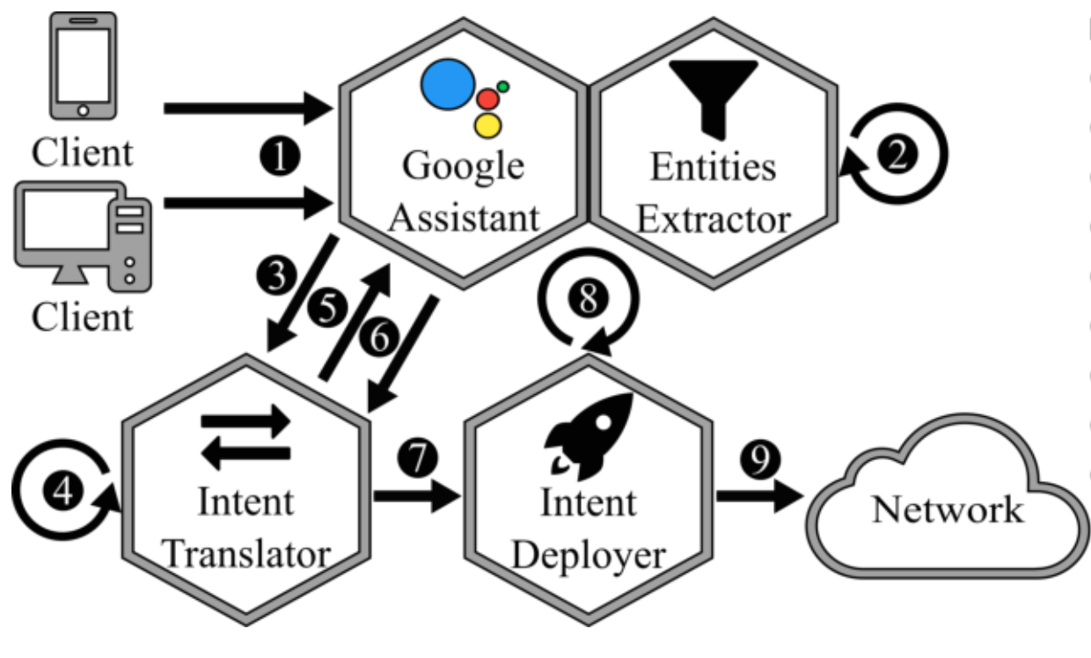
Example of Intent translation process
Receive operator input as text
Extract entities from input
Send entities to translator
Translate entities to Nile
Request operator’s feedback
Receive operator’s confirmation
Send Nile intent to deployer
Compile Nile intent into network policy
Deploy network policy
Jacobs, A. S.; Pfitscher, R. J.; Ferreira, R. A. & Granville, L. Z.
Refining Network Intents for Self-Driving Networks
Notes:
Intent Tranlsation process that uses machine learning and feedback from the operator to translate intents into network configurations. The proposed refinement method extracts an intermediate representation of intent from natural language before compiling it into SDN commands.
The intent is collected through a chat interface.
a neural network learning model is used to extract entities from natural language. (DialogFlow framework is framework to build human-computer interactions based on natural language conversations )
A previously trained sequence-to-sequence learning model based on a Recurrent Neural Network (RNN) is used to translate extracted entities to structured intents written in the Nile language.
The extracted Nile intent acts as an abstraction layer for lower-level configuration and policy languages.
The structured intent definition generated by the translation model is then presented to the network operator for confirmation.
The operator may either confirm the correctness of the intent program or make adjustments if necessary. Based on the user’s response, the translation model is then trained, ensuring that the results improve every time the operator provides new intent.
Finally, having a structured intermediate intent representation verified by the user, the Intent Deployer can compile and deploy it into configuration commands using SONATA-NFV.

Slide 14
Intent fulfillment and conflict resolution
Inconsistency, missing network functionalities, or conflicts with existing intents might occur.
Intent validation and feasibility checking are required.
Conflicts among intents require intent coordination and conflict determination, prevention, and resolution.
Notes:
1. in order to avoid conflicts that might occur due to inconsistency, missing network func- tionalities, or conflicts with existing intents. Infeasible intents should be rejected and the system has to provide an operator with appropriate feedback.
2. Valid intents should still be checked for technical feasibility. Thus, it is necessary to monitor, collect and store network state data and capabilities.
3. In order to solve conflicts in network control and management, simple forms of coordination, such as prioritization, partial fulfillment, or queuing were proposed. There are also abstract approaches that use the tools of formal languages and first-order logic to handle conflicts

Slide 15
Lack of standardization
Independent exploration and development of IDN by various research groups, open-source communities, and industrial companies.
Existing IDN frameworks are based on heterogeneous architectures and underlying techniques.
The absence of a standardized intent format and common architecture is one of the main challenges.

Slide 16
Conclusion
IDN is a concept that tends to automate conventional network management.
Intent offers an efficient and powerful way to manage network infrastructure, resources, and services without providing exact configurations.
However, IDN faces several challenges and requires further research.
Integration of artificial intelligence is a key to automating network operations.

